Slide 1
Perceptron

Slide 2
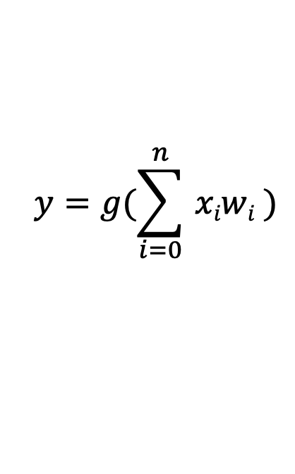
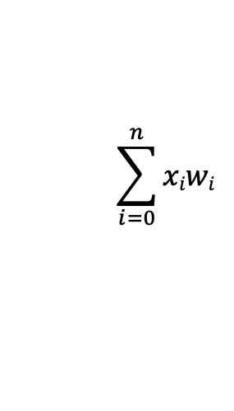
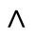
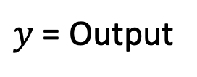
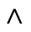
Perceptron: Forward Propagation
bias
X₀
Non-linear Activation
function
X₁
W₀ = 1
$$y=g(\sum_{i=0}^{n}{ xiwi} )$$
W₁
$$<$$
$$<$$
$$\sum_{i=0}^{n}{xiwi}$$
$y$ = Output
X₂
W₂
g(.)
W_{n}
x_{n}
Inputs
Learnable Parameters
Sum
Non-Linearity
Output

Slide 3
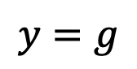
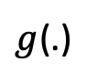
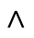
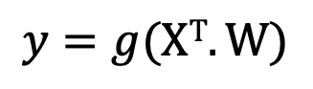
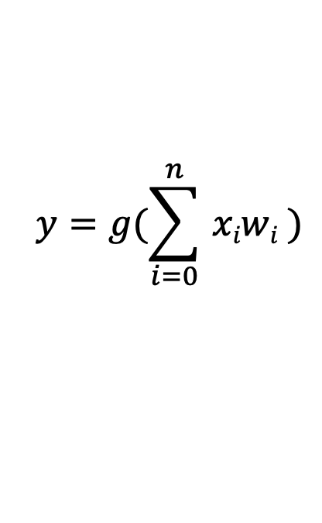
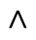
Perceptron: Forward Propagation
$$y=g(\sum_{i=0}^{n}{ xiwi} )$$
$$<$$
bias
X₀
Non-linear Activation
function
X₁
W₀ = 1
W
W₁
X^{T}
$$<$$
$$\sum_{i=0}^{n}{xiwi}$$
$y$ = Output
1
X₂
W₂
$g$(.)
$$<$$
W₁
$$y=g$$
X₀ X₁ .. X_{n}
x
W_{n}
W_{n}
x_{n}
$$<$$
$$y=g(XT.W)$$
Inputs
Learnable Parameters
Sum
Non-Linearity
Output

Slide 4
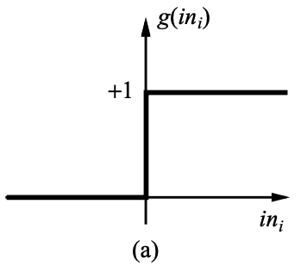
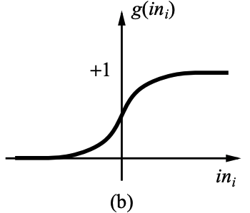
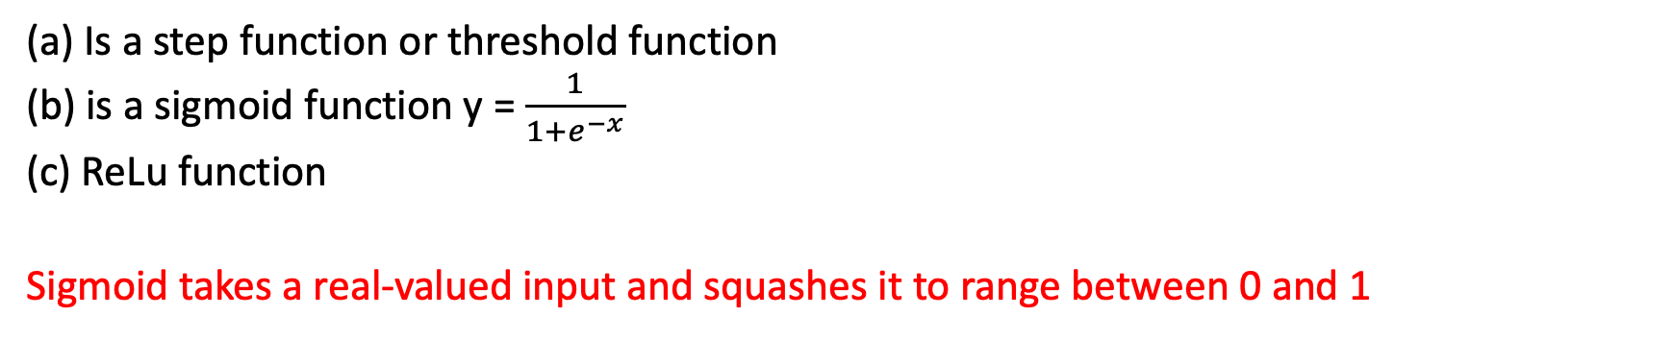
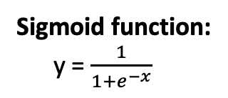
Activation function
ReLU function:
x x => 0
0 x < 0
Sigmoid function:
y = $\frac{1}{1+e^{−x}}$
y
y
y
y =
x
x
x
(c)
(a) Is a step function or threshold function
(b) is a sigmoid function y = $\frac{1}{1+e^{−x}}$
(c) ReLu function
Sigmoid takes a real-valued input and squashes it to range between 0 and 1

Slide 5
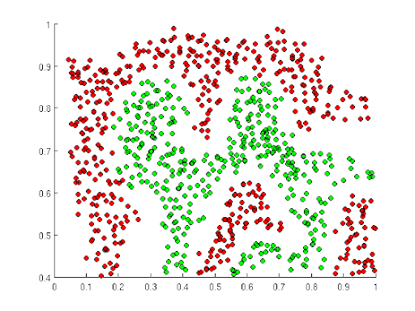
Importance of Activation Functions
The purpose of activation functions is to introduce non-linearities into the network.

Slide 6
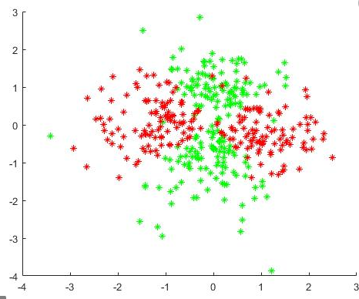
Importance of Activation Functions
Build a neural network to distinguish green vs. red points

Slide 7
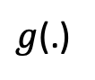
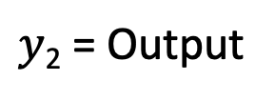
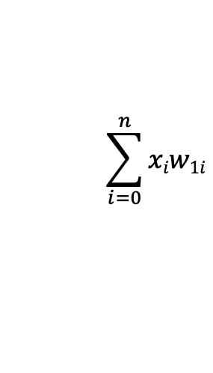
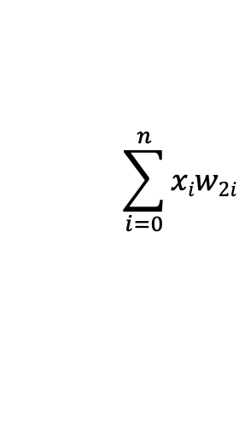
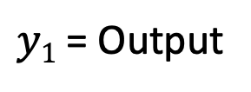
Multi Output Perceptron
Non-linear Activation
function
$$<$$
$$\sum_{i=0}^{n}{xiw1i}$$
$y1$ = Output
X₀
$g$(.)
X₁
Non-linear Activation
function
$$<$$
$$\sum_{i=0}^{n}{xiw2i}$$
$y$₂ = Output
x_{n}
$g$(.)

Slide 8
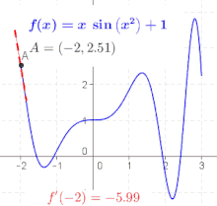
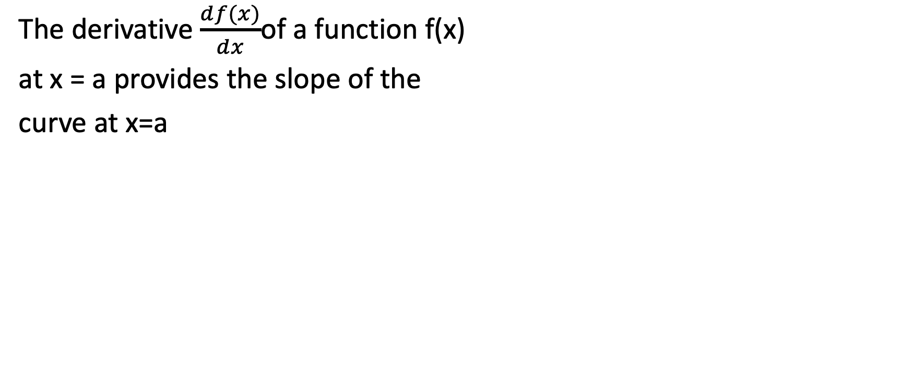
Derivative
The derivative $\frac{df(x)}{dx}$of a function f(x)
at x = a provides the slope of the
curve at x=a

Slide 9
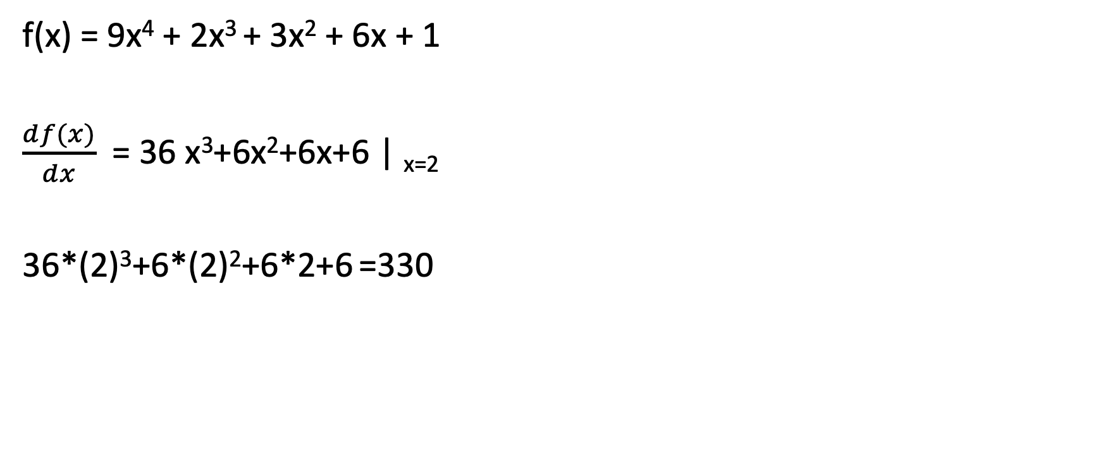
Calculate Derivative with Pytorch
f(x) = 9x⁴ + 2x³ + 3x² + 6x + 1
$\frac{df(x)}{dx}$ = 36 x³+6x²+6x+6 | _{x=2}
36*(2)³+6*(2)²+6*2+6 =330

Slide 11
Gradient descent
Pick a starting point (w)
repeat until loss doesn’t decrease in all dimensions:
pick a dimension
move a small amount in that dimension towards decreasing loss (using the derivative)

Slide 12
Gradient

Slide 13
Learning Rate: Steps
Learning Rate should increase with the slope

Slide 14
Dropout
Randomly set some neurons to zero in the forward pass
After Applying Dropout
Srivastava et al., 2014, https://www.cs.toronto.edu/~hinton/absps/JMLRdropout.pdf

Slide 15
Dropout
Forces the network to have a redundant representation

Slide 16
Overfitting revisited: regularization
A regularizer is an additional criteria to the loss function to make sure that we don’t overfit
It’s called a regularizer since it tries to keep the parameters more normal/regular
It is a bias on the model forces the learning to prefer certain types of weights over others

Slide 17
Common regularizers
sum of the weights
sum of the squared weights
Squared weights penalizes large values more
Sum of weights will penalize small values more

Slide 18
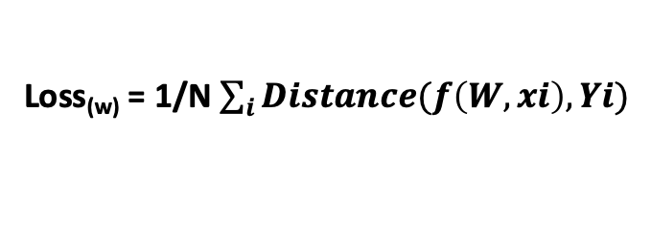
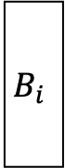
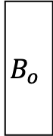
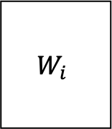
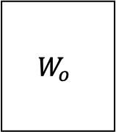
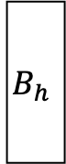
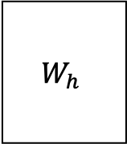

Deep Neural Network (DNN)
3 Layer Neural Network
Froward Propagation →
Training data
$$x$$
$$W_{i}$$
$$B_{i}$$
$$W_{h}$$
$$B_{h}$$
$$W_{o}$$
$$B_{o}$$
Predicted data
Loss
Stochastic Gradient Descent
Actual data
← Back Propagation
Loss_{(w)} = 1/N $\sum_{i}{Distance(f\left(W,xi\right), Yi)}$

Slide 19
DNN Assignment -1
Representation Learning: We call this vector with lower dimensionality: Latent Features, Feature Representations, or Embedding Representation of the Input) with respect to the learned task.
Vector
Vector
Vector
7
8
4
1
2
8
64
Vector
“3”
₀
₀
₀
₁
₀
₀
₀
₀
₀
₀
x W₁
+
b₁
RELU
x W₂
+
b₂
RELU
x W₃
+
b₃
y
S(y)
[784 x 128]
[128 x 64]
[ 64 x 10]
[1x 784]
x
[784 x 128]
+
[1x 128]
[1x 128]
x
[128 x 64]
+
[1x 64]
[1x64]
x
[64 x 10]
+
[1x 10]
28 X 28 = 784
[28x28] → [1x784]
Flatten a Matrix to a vector
One hot encoding:
Sparse representation of output

